Slide 1
CSC1031: OOP
Week 2
Java Ecosystem

Slide 2
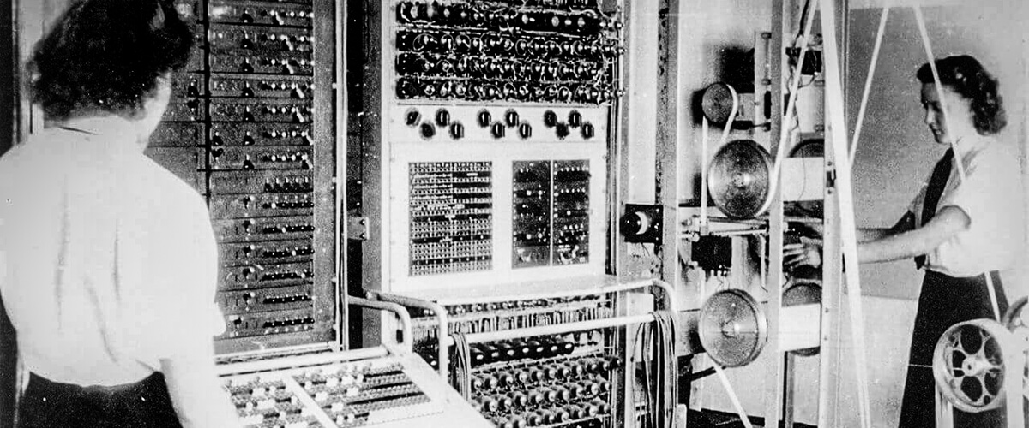
The Evolution of Programming
Early Days: Machine Code
Programming with raw binary (0 and 1).
Extremely error-prone and difficult to read.
No portability: programs tied to specific hardware.

Slide 3
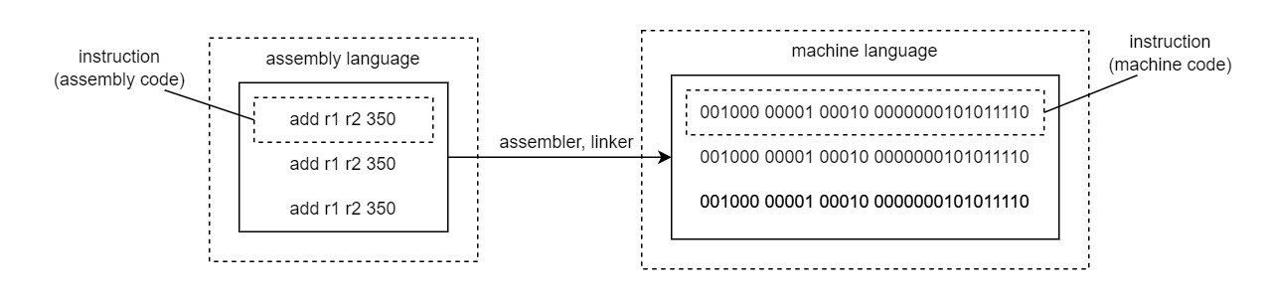
The Evolution of Programming
Assembly Language: A Step Forward
Mnemonic codes (ADD, SUB) instead of binary.
Easier to understand but still tied to hardware.
Required an assembler to translate to machine code.

Slide 4
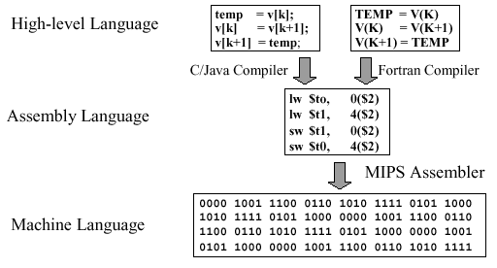
The Evolution of Programming
High-Level Languages: Abstraction Begins
Introduction of languages like FORTRAN, C, and Pascal.
Human-readable syntax (if, while, print).
Compiled into machine code for execution.
Limited portability across systems.

Slide 5
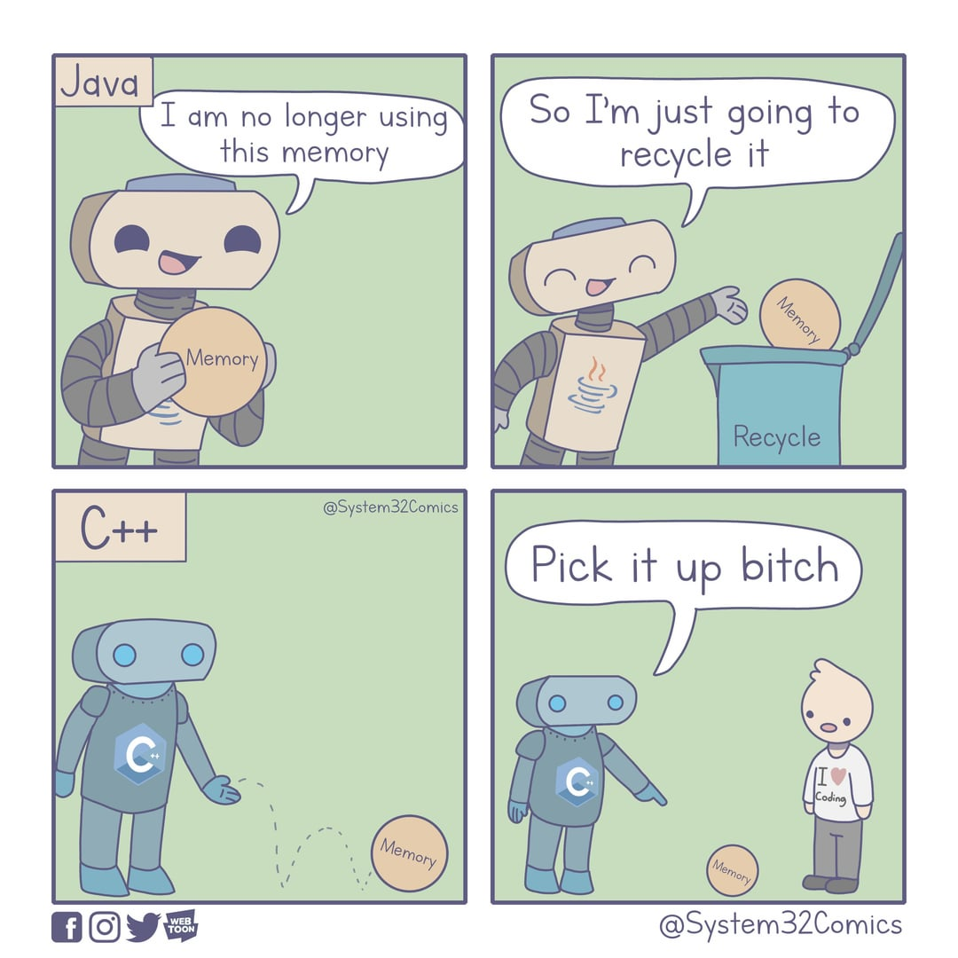
C++
C++ programs are compiled directly into platform-specific machine code by a compiler (e.g., GCC, MSVC).
The output is tailored for the operating system and processor architecture where it was compiled.
C++ often includes platform-specific system calls and libraries, further limiting portability.
C++ developers manage memory manually, which can lead to undefined behavior on certain platforms if not handled carefully.

Slide 6



The Birth of Java
Introduced by Sun Microsystems in 1995.
Created by James Gosling and his team.
Originally designed for interactive television systems.

Slide 7
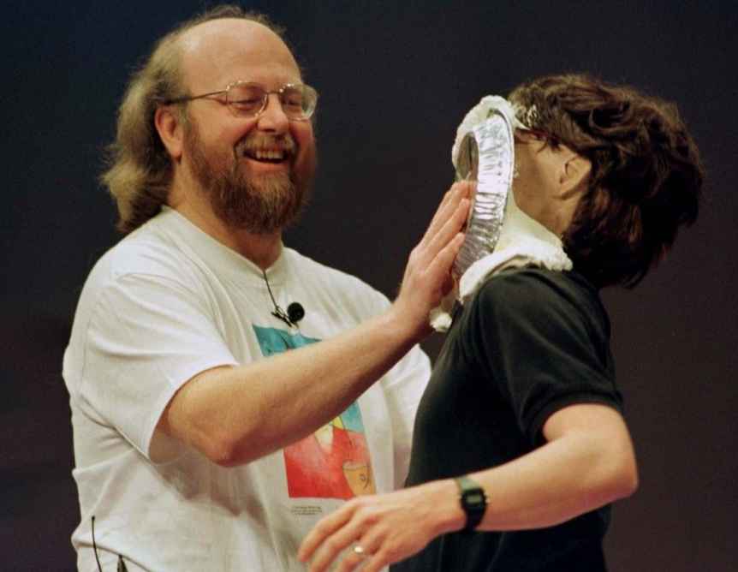






Slide 8
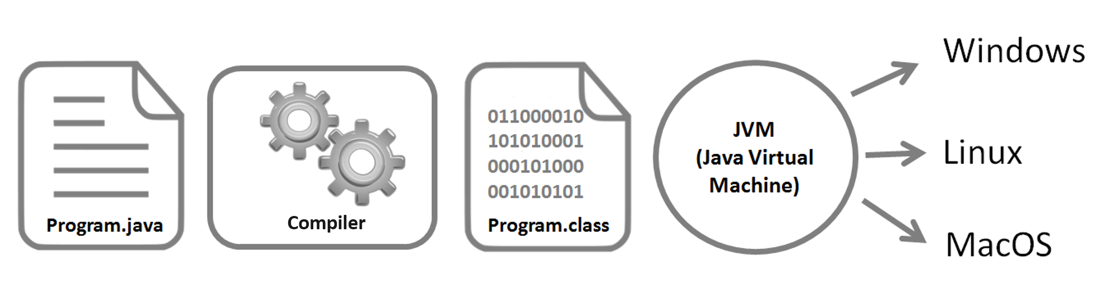
Platform Independence Write Once, Run Anywhere (WORA)
Java programs are compiled into bytecode, a universal format.
Bytecode is executed by the JVM (Java Virtual Machine), which is platform-specific.
This ensures Java programs run on any device with a compatible JVM.
Benefit: Eliminates platform-specific dependencies.

Slide 9
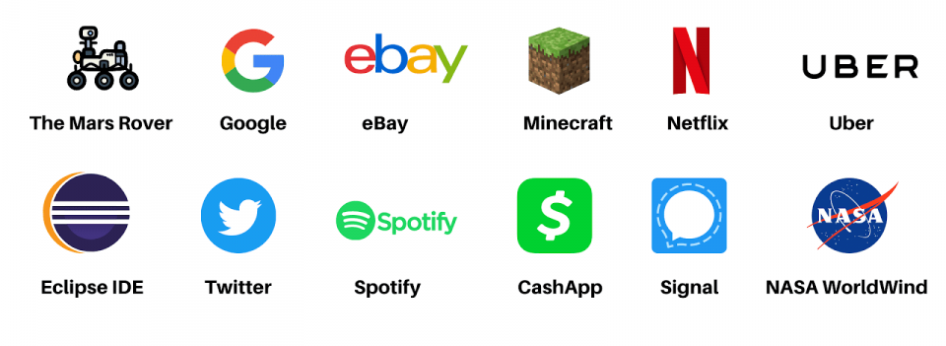

Slide 10
C++
Source Code (.cpp) -> Compiler -> Assembly Code -> Assembler -> Binary Code (Machine Code)
Java
Source Code (.java) -> Compiler (javac) -> Bytecode (.class) -> JVM -> Binary Code (Machine Code)

Slide 11
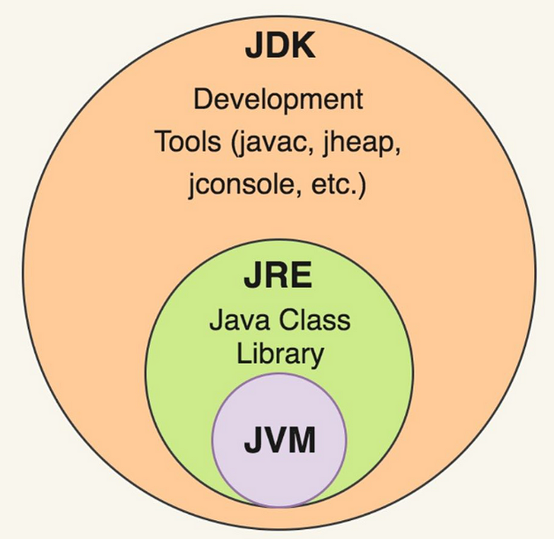
Java Ecosystem Overview
Key components:
JDK: Development tools.
JVM: Runs Java programs.
JRE: Bridges development and execution.

Slide 12
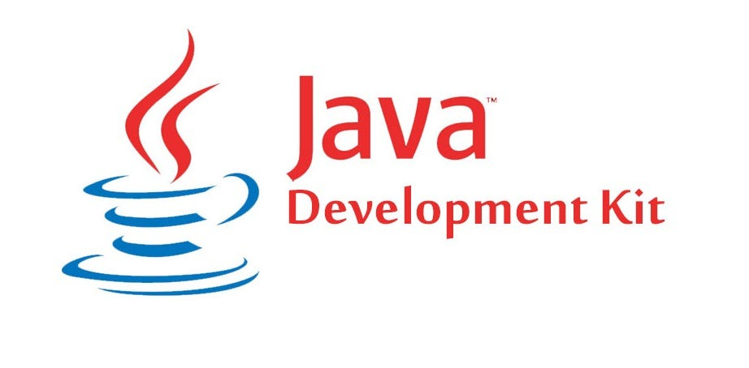
Java Development Kit (JDK)
Purpose:
A toolkit for developers to write, compile, and debug Java applications.
Key Components:
Compiler (javac): Converts source code to bytecode.
Debugger (jdb): Helps identify and fix issues.
Libraries and Tools: Pre-built code and utilities for development.
Who uses it?
Developers building Java applications.

Slide 13
Java Virtual Machine (JVM)
Purpose:
Runs Java bytecode and ensures platform independence.
Responsibilities:
Bytecode Interpretation: Converts .class files into machine code.
Memory Management: Automatic garbage collection.
Security: Executes code in a sandboxed environment.
JVM is platform-specific but runs the same bytecode universally.

Slide 14
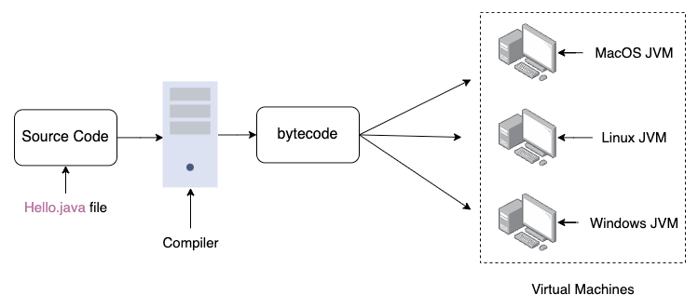
Java Virtual Machine (JVM)

Slide 15
Java Runtime Environment (JRE)
Purpose:
Provides everything needed to run Java programs.
Components:
JVM: Executes bytecode.
Libraries: Pre-packaged Java APIs for functionality (e.g., java.util, java.io).
Other Tools: Assists program execution (e.g., java command).
Who uses it? End-users running Java applications, not writing them.

Slide 16
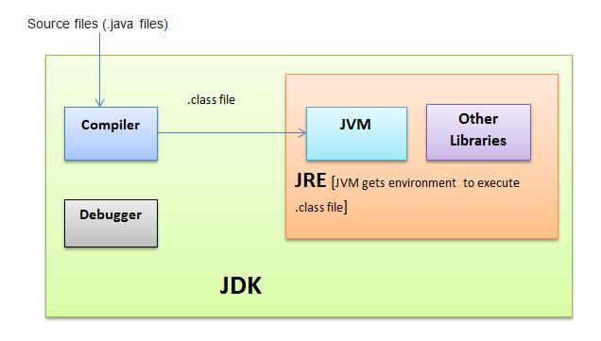
Source Code → JDK (javac) → Bytecode (.class) → JRE (JVM) → Binary Code.

Slide 17
Java basics

Slide 18
Strong Typing
Strong Typing:
Variables must be declared with a specific type (int, String, etc.).
Prevents accidental type errors during development.
Reliability:
Robust exception handling ensures stability.
Garbage collection manages memory automatically.
Security features prevent unauthorized operations.
Java's design focuses on consistent, error-free execution.

Slide 19
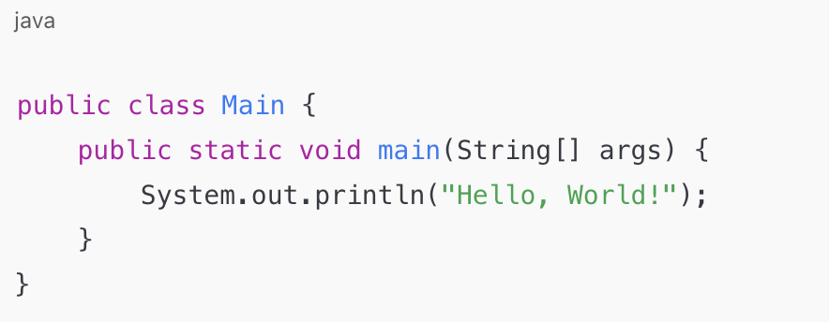
The Main Class
Every Java program starts execution from the main method
The entry point of a Java program
The JVM looks for the main method to begin execution.
Accessible to the JVM
Belongs to the class, not an instance.
No return value.
Used for command-line arguments

Slide 20
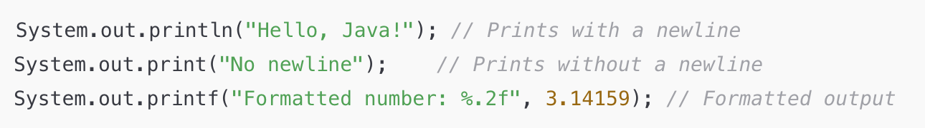
Java Output
System.out.println: Used to print messages to the console.
What is System.out?
A built-in Java class in the java.lang package.
Provides access to system-related functionality.

Slide 21
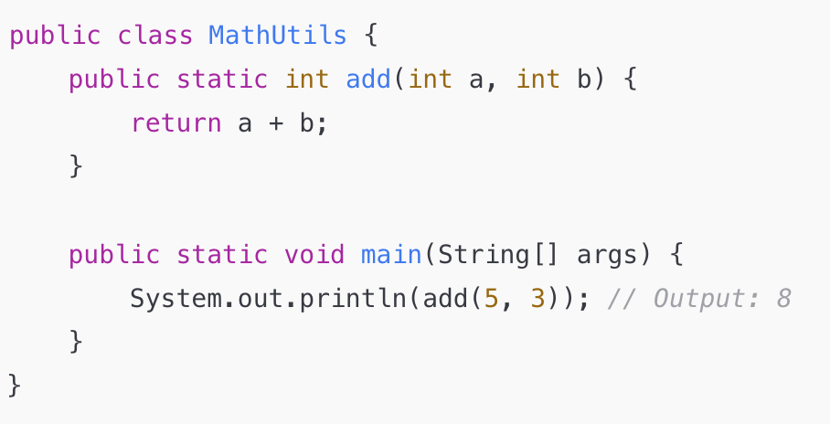
What is ”static”
Java requires methods to exist inside classes.
The static keyword allows calling methods without creating an object

Slide 22
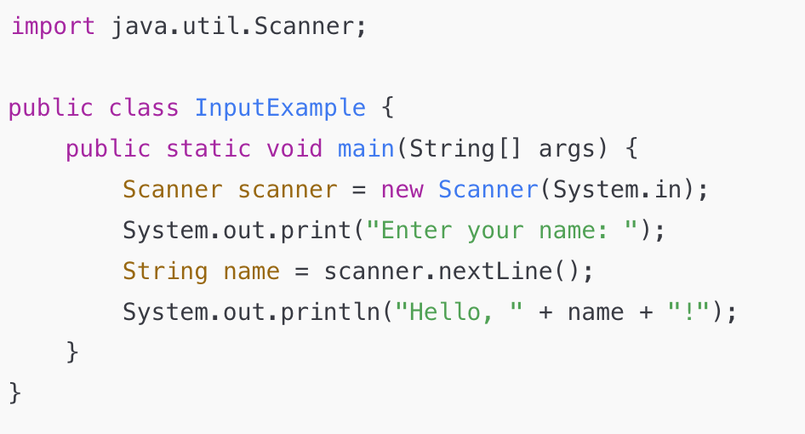
Java Input
Use the Scanner class for input
Key Methods:
nextLine(): Reads a line of text
nextInt(), nextDouble():
Reads numbers

Slide 23
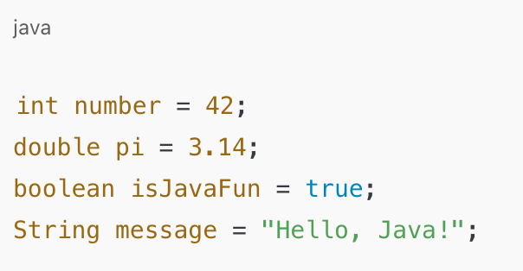
Java Data Types
Java supports two main types:
Primitive Types:
byte, short, int, long (integer types).
float, double (floating-point numbers).
char (single characters).
boolean (true/false).
Reference Types:
Objects and arrays.
Why use them?
Primitives: For efficiency and speed.
Reference types: For flexibility and object-oriented programming.

Slide 24
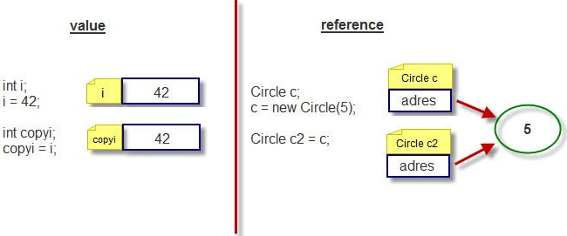
Reference type
Instead of holding the actual value, a reference type stores a reference (or address) that points to the memory location where the object or data is stored.

Slide 25
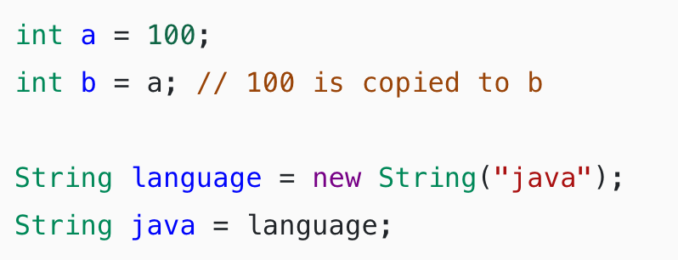
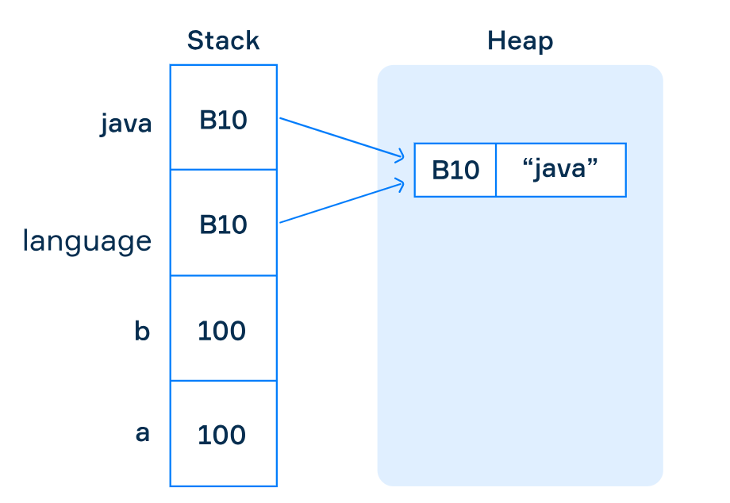
Stack and Heap
Reference types use heap memory for dynamic allocation of objects.
The reference itself resides in the stack memory.
stack and heap are types of memory areas used by the Java Virtual Machine (JVM)

Slide 26
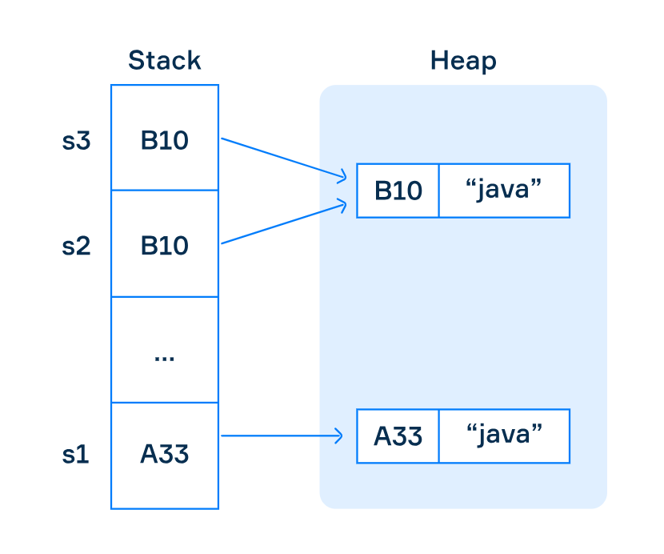
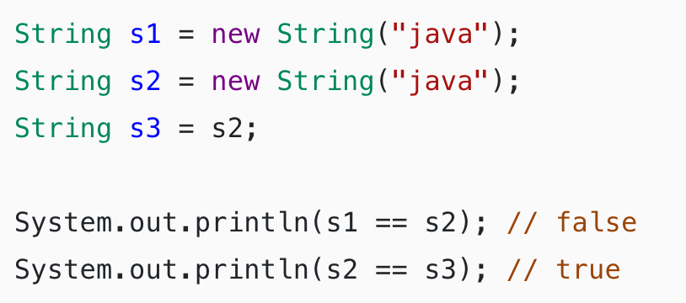
Stack and Heap
Stack: Temporary storage for method execution, local variables, and references.
Heap: Long-term storage for objects and shared data, managed by the garbage collector.

Slide 27
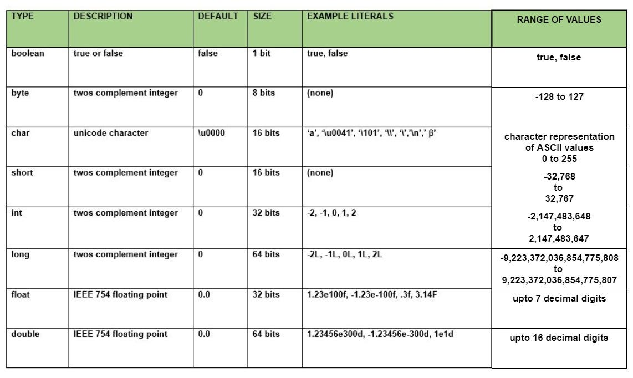

Slide 28
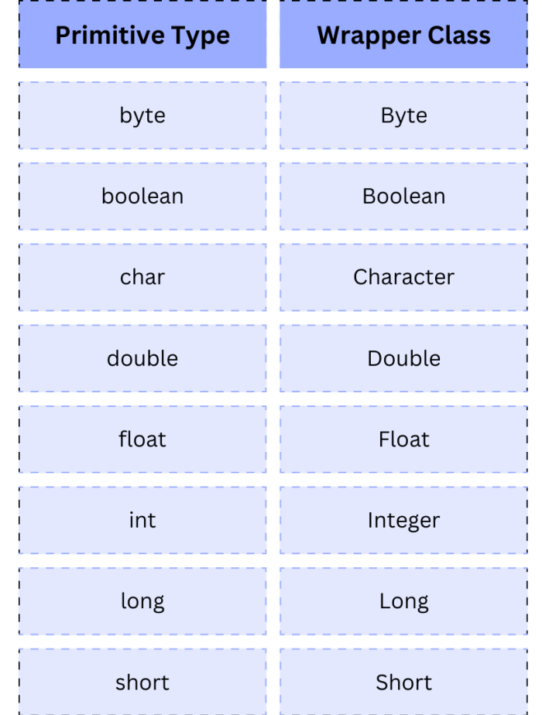
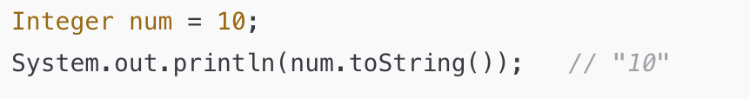
Wrappers
Wrapper classes provide an object representation for primitive types.
Collections like ArrayList can only store objects.
Autoboxing / Unboxing
Conversion of a wrapper type to its primitive and back
It is automatic

Slide 29
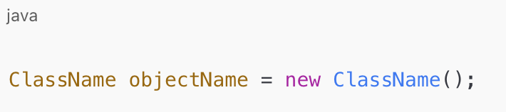
What is the new Keyword in Java?
The new keyword is used to create objects in Java.
It dynamically allocates memory in the heap for an object.
Instantiates objects from classes.
Returns a reference to the created object.

Slide 30
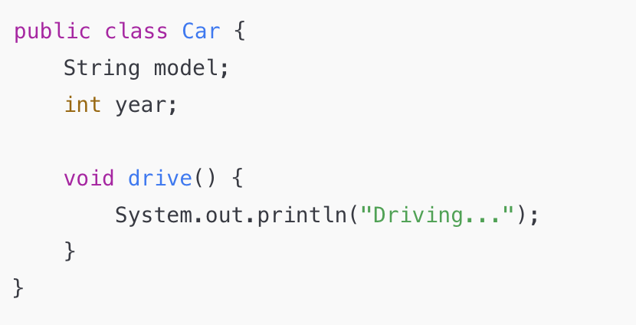
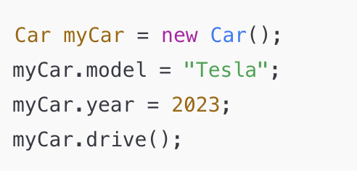
Steps when new is used
Allocates memory for the object in the heap.
Initializes instance variables with default values.
Invokes the constructor to set initial values.
Returns the memory reference to the object.

Slide 31
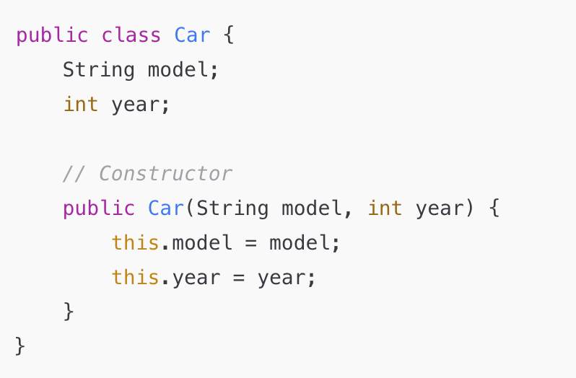
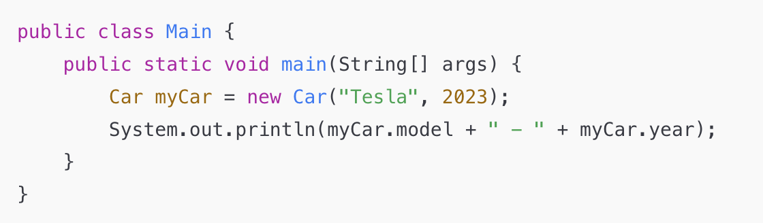
Constructors in Java
What is a Constructor?
A special method used to initialize objects.
Same name as the class.
No return type.

Slide 32

Garbage Collector

Slide 33
What are Destructors?
In languages like C++, a destructor is a special method called automatically when an object is destroyed or goes out of scope.
Release resources like memory, file handles, or network connections
Prevent resource leaks
Java does not have destructors because
Java's Garbage Collector automatically reclaims memory for unused objects
When there are no more references to an object, it becomes eligible for garbage collection
there’s no guarantee when an object will be garbage collected

Slide 34
Common Tools for Java Development
Key Categories:
IDEs for writing and debugging code.
Build Tools for automating compilation and packaging.
Package Management for managing libraries and dependencies.

Slide 35
Integrated Development Environments (IDEs)
Tools that provide an integrated workspace for coding, debugging, and testing Java applications.
Popular IDEs:
IntelliJ IDEA
Eclipse
NetBeans
Code editor with syntax highlighting and autocompletion
Debugger for stepping through code
Integrated build and version control tools
Support for plugins

Slide 36
Build Tools
Automate tasks like compiling code, packaging applications, and managing dependencies.
Popular Build Tools:
Maven:
Uses an XML file (pom.xml) for project configuration.
Focuses on dependency management and standard project structures.
Gradle:
Uses a Groovy or Kotlin-based build script.

